Slide 1

WEB BASED ATTENDENCE MANAGEMENT

Slide 2
TEAM MEMBERS
S.NO | NAME | REG.NO
1 | SHANE STEFFY S | 727821TUIC031
2 | SUREKHA S S | 727821TUIC034
3 | SWARNA LAKSHMI D M | 727821TUIC036
4 | DANIEL MATHEWS R | 727822TUIC602
5 | KOWSIKAN P | 727822TUIC604
6 | MOHAMED AARIF A | 727822TUIC605
7 | NITHISH BALAJI A S | 727822TUIC607

Slide 3
ABSTRACT
The main aim of the project is to maintain attendance records and progress record of student for any organization school or college.
We developed this website application using Java language in Visual Studio Code and by taking react as a main thing we are using Figma to create website interfaces.

Slide 4
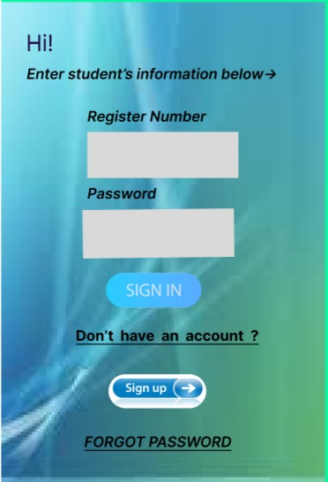
DESKTOP 1

Slide 5
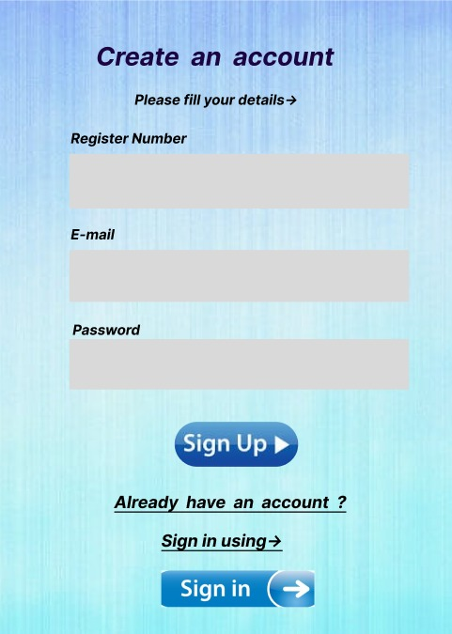
DESKTOP 2

Slide 6
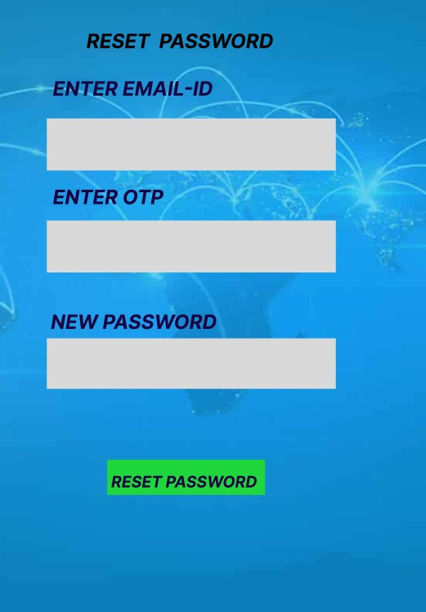
DESKTOP 3

Slide 7
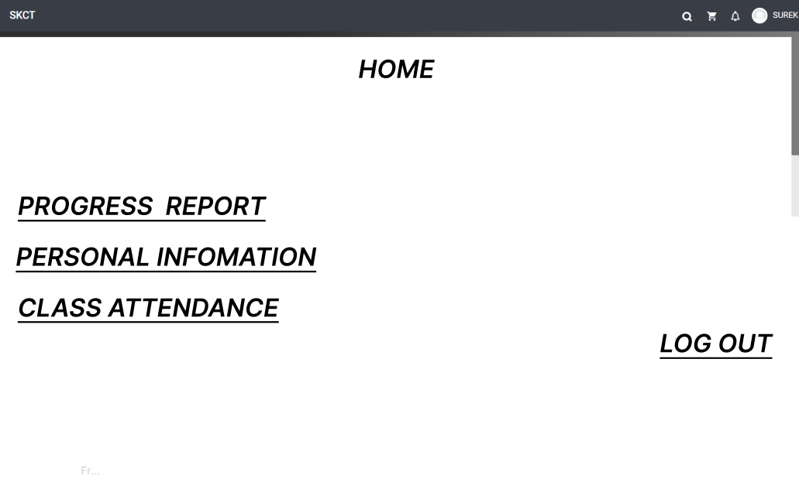
DESKTOP 4

Slide 8
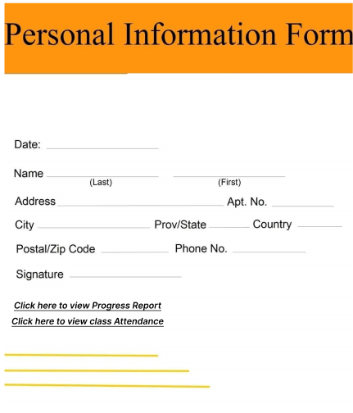
DESKTOP 5

Slide 9
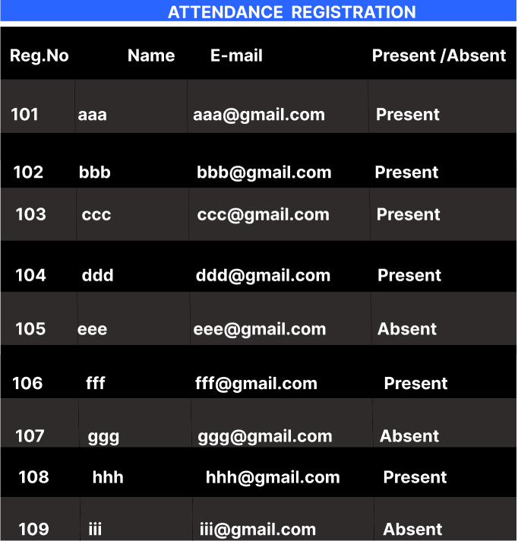
DESKTOP 6

Slide 10
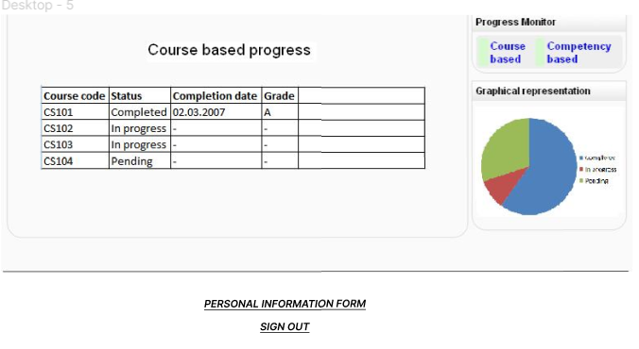
DESKTOP 7

Slide 11
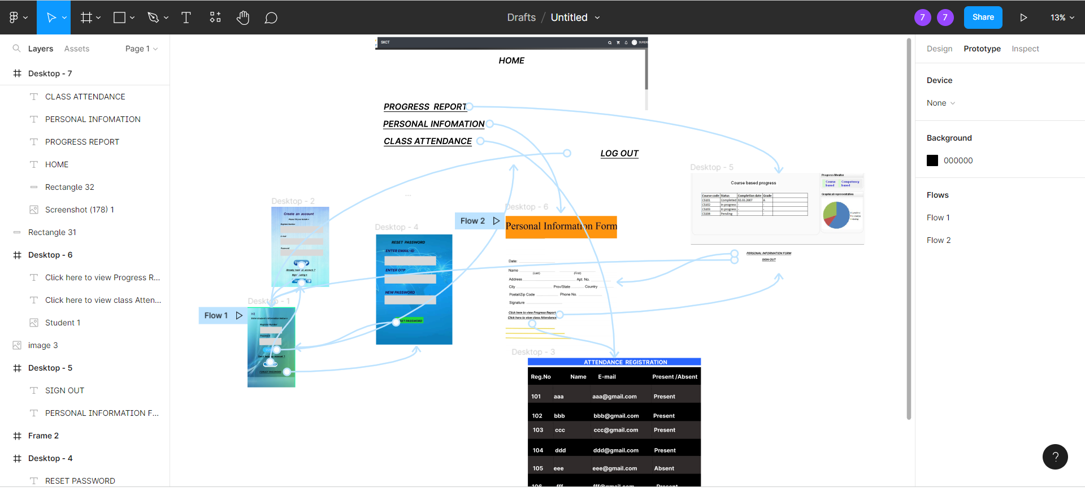
PROJECT FLOW

Slide 12
LINK
https://www.figma.com/file/Qeeb8bQbDMkVpcPMCGz5ZD/Untitled?node-id=0%3A1

Slide 13
THANK YOU

